Slide 1
2. Data Extraction

Slide 2



Dependent Variables
Response variables
Dependent Variable is outcome or result variables that we are interested in understanding, explaining or predicting.
In other words, the variable whose behavior/ values are affected by the change in the independent variables
Monthly sales (of selected performance indicator) for study product at Physician / Account level (or lowest granularity available)
The following would be the response variables -
Vaccines drugs – Doses
Chronic care drugs – NRx/TRx
Oncology – Quantity / Vials
Units Sold
Revenue Sales
TRx / NRx
New Patients

Slide 3



Independent Variables
Promotions
Independent variables are the ones that cause changes to (i.e., impact) the outcome variable (i.e., dependent variable)
Objective is to understand and explain how each of the independent variable impacts the outcome.
Promotions related variables are of main focus of inference and all other independent variables are used to control for market behaviors and their impacts to outcome variables.
Identify relevant channels for inference and measurements
Identify relevant control factors (ex: carryover, trends, seasonality, managed care etc)
Detailing data (daily, or as available)
Activity data for other promotion channels
Detailing (Calls)
Emails
Medical Journal
Medical Education
Competitor Sales
Banner
Social Media
Promo Call
Managed Care

Slide 4
Brand Financials and bridge files
Brand financials
Sales force information Fully loaded cost of a rep Call capacity/ rep
Promotional Channel spend HCP vendor channel spend Consumer channel spend
Brand financials Profit margins or Net present value
Bridge Files
Demographics: Physician demographic Census / Population distribution
“Bridge” files Any bridge file that might be needed to bring different data together, e.g. Current segmentation Physician to ZIP mapping ZIP to DMA Code mapping Physician-to-Account affiliation

Slide 5
DataLake
DataLake – A centralized repository where it allows you to store and manage large volume of data.
Steps to access the Data Lake
Raise a request to the data lake team
Once access is given follow the below steps -
Go to the link - https://merckcloud-auth.merck.com/
Search for “MMC HHDNACENTR PROD” > Console Login
In the console home > select “Athena” where you will be logging in into query
Confluence link - https://share.merck.com/display/HHDNAT/Marketing+Mix+Modeling+Dataset

Slide 6
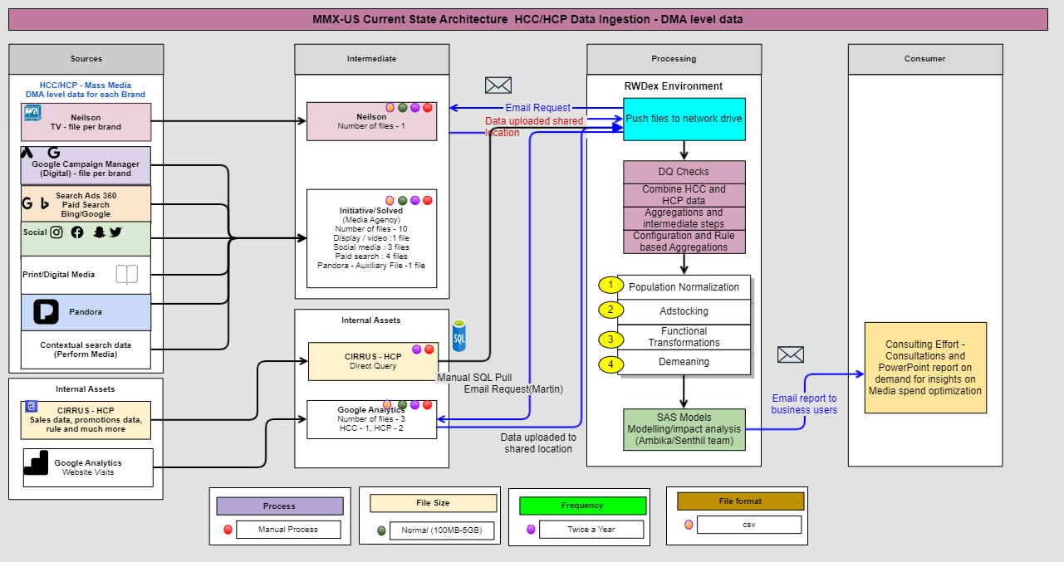
Architecture

Slide 7
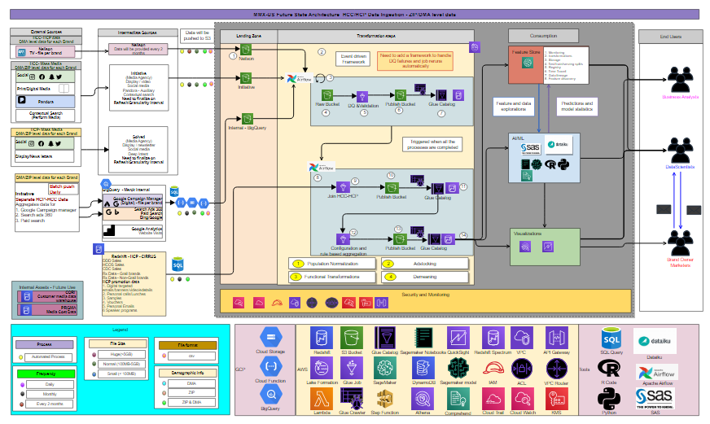
Future Architecture

Slide 8
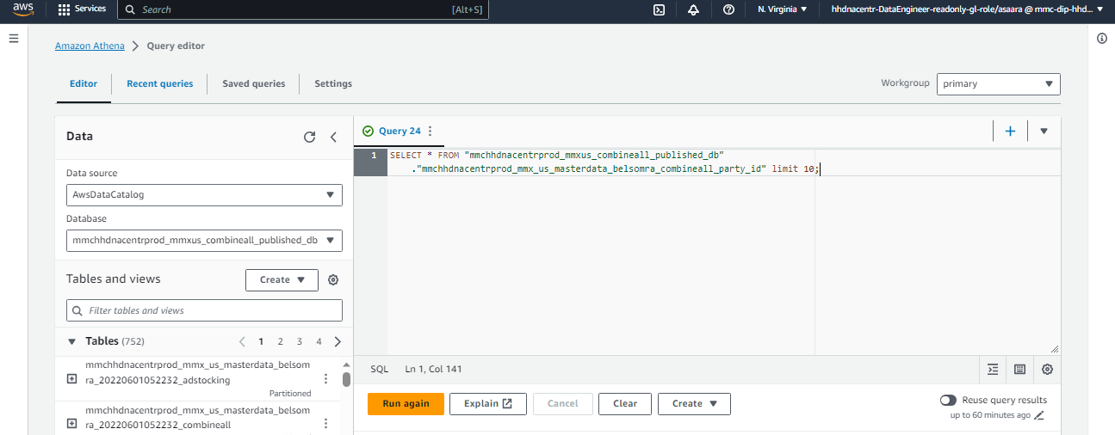
Athena Query Editor
Ensure you are keeping the location as “N. Virginia”
New Query
Data source
Query editor – where you can write the SQL queries
Databases
Tables

Slide 9
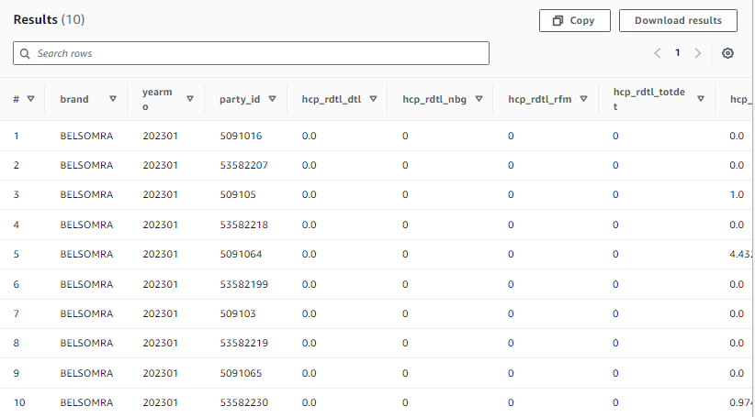
Athena Query Results (Belsomra Sample Output)
Download the results

Slide 10
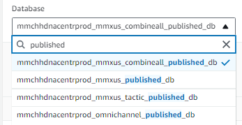
Databases/Tables
For MMM purpose we need access to the three databases –
mmchhdnacentrprod_mmxus_combineall_published_db
The database would consist of master data tables brand wise at party id, zip, zip3 and dma level granularities with all the relevant metrics (sales, each promotional channel – engagements, clicks, impressions, details, attended, samples, vouchers)
mmchhdnacentrprod_mmxus_published_db
The database would include the individual promotional tables for all the brands (consumer, hcp personal and hcp non-personal channels)
mmchhdnacentrprod_mmxus_tactic_published_db
The database would consist of tables by brand wise for hcp non personal channel by campaign x vendor x tactic level metrics

Slide 11
Data Extract steps for Belsomra
Step 1: Login into your Athena account.
Step 2: Go to settings-> Go to Query result location (Query result and encryption settings)-> Create New Folder (where your files can be saved)
Step 3: Run Master data parquet code:
“Create Master Data prq for DMA Level
UNLOAD ( SELECT * FROM "Insert the required dataset from the view table of athena " ORDER BY zip3, yearmo)
TO 'insert the location of the new created folder in step 2’ WITH (format = 'PARQUET',compression = 'GZIP’);”
Step 4: After running this code download the PARQUET files from the created folder in step 2.
Step 5: Then upload this PARQUET files to SAS using WINSCP or manually upload (less than 10 MB).
Step 6: Convert PARQUET files to csv using Jupiter notebook (Prq to csv)
Remember the number of PARQUET files present should be divisible by the number of csv files created.
For Example, If number of PARQUET files are 30 then create 5 or 10 CSV files (num_parts) as it is divisible.
Step 7: After running this code we must import the csv files in SAS.
proc import datafile="csv file location on SAS “ out = temp1; guessingrows= 5 ;run;

